Slide 1
影像處理、電腦視覺及深度學習概論 (Introduction to Image Processing, Computer Vision and Deep Learning) Homework 2
TA: 謝是奎
Gmail: nckubot65904@gmail.com
Office Hour: 10:00~12:00, Mon.
10:00~12:00, Thu.
At CSIE 9F Robotics Lab.

Slide 2
Notice (1/3)
Copying homework is strictly prohibited!! Penalty: Both individuals will receive a score of 0!!
Due date => 09:00:00, 2025/12/30 (Tue.)
Do not submit late, or the following points will be deducted:
Submit within seven days after the deadline, and your score will be reduced by half.
If you submit after this period, you will receive a score of 0.
You must attend the demonstration, otherwise your score will be 0. The demonstration schedule will be announced on NCKU Moodle.
You must create GUI, otherwise your point will be deducted.
Upload to => 140.116.154.28 -> Upload/Homework/Hw2
User ID: opencvdl2025 Password: RL2025opencv
Format
Filename: Hw2_StudentID_Name_Version.rar
Ex: Hw2_F71234567_林小明_V1.rar
If you want to update your file, you should update your version to be V2,
Ex: Hw2_F71234567_林小明_V2.rar
Content: Project folder *( Excluding the pictures )
*Note: Remove your “Debug” folder to reduce file size.

Slide 3
Notice (2/3)
Submitted File Stuucture
Hw2_StudentID_Name_Version // project folder
|-- Hw1
|-- model // folder to put trained models
|-- Weight_Sigmoid.pth
|-- Weight_Relu.pth
|-- Loss&Acc_Sigmoid.jpg
|-- Loss&Acc_Relu.jpg
|-- main.py // codes for your GUI program
|-- train.py // codes for model training
|-- ⁞ // other files or folders you need
|-- Hw2
|-- model // folder to put trained models
|-- weight.pth
|-- Loss&Acc.jpg
|-- main.py // codes for your GUI program
|-- train.py // codes for model training
|-- ⁞ // other files or folders you need

Slide 4
Notice (3/3)
Python (recommended):
Python 3.9 (https://www.python.org/downloads/)
Opencv-contrib-python (4.12.0.88)
Matplotlib 3.9.4
UI framework: pyqt5 (5.15.11)
Pytorch 2.8.0
Torchvision 0.23.0
Torchsummary 1.5.1

Slide 5
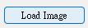
Assignment Scoring (Total: 100%)
1. (50%) Train a MNIST Classifier using LeNet-5
1.1 (15%) Implement Lenet-5 from Scratch And Show Model Architecture.
1.2 (15%) Evaluate Training And Validation Accuracy/Loss And Compare The Performance of Sigmoid And Relu Versions.
1.3 (20%) Use The Model with The Highest Validation Accuracy to Run Inference, And Show The Predicted Distribution And Class Label.
2. (50%) Train a CIFAR-10 Classifier using ResNet18
2.1 (10%) Load and Show the Image
2.2 (10%) Show the Architecture of ResNet18 Model
2.3 (15%) Show Training/Validating Loss Curve and Accuracy Curve
2.4 (15%) Use the Trained Model with Highest Validation Accuracy to Run Inference, Show the Probability Distribution and Class Label
(出題：Ying)
(出題：Ian)
* Don’t fix your image and video path
(There is another dataset for demonstration)
Load image and video please use the following function to read the path.
QFileDialog.getOpenFileName

Slide 6
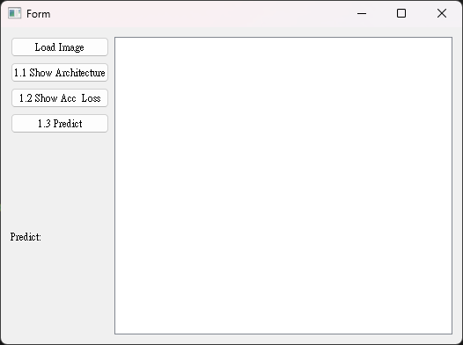
1. Train a MNIST Classifier using LeNet-5 (50%)
(出題：Ying)
1.1 (15%) Implement LeNet-5 from scratch and show model architecture.
1.2 (15%) Evaluate training and validation accuracy/loss and compare the performance of Sigmoid and ReLU versions.
1.3 (20%) Use the model with the highest validation accuracy to run inference, and show the predicted distribution and class label.
Figure: GUI example

Slide 7
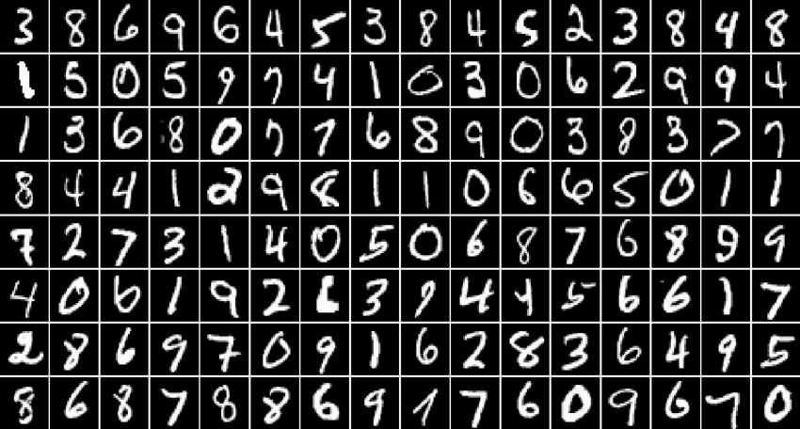
1.0 Train a MNIST Classifier using LeNet-5 (50%)
Requirement
Train from-scratch implementation of LeNet-5 model using PyTorch.
Download dataset using torchvision.datasets.MNIST() (tutorial)
Training data: 60000 images
Validation data: 10000 images
Resize image from (28, 28) to (32, 32)
Parameters
At least 15 epochs.
Cross entropy loss
Adam optimizer
Record training/validation loss and accuracy in .jpg or .png format.
In the submitted file, you need to include
Figure of training/validating loss and accuracy in .jpg or .png format.
Code for your GUI program
Code for model training.
Please do not include image data in the submitted file.
(出題：Ying)
Reference: LeNet-5

Slide 8
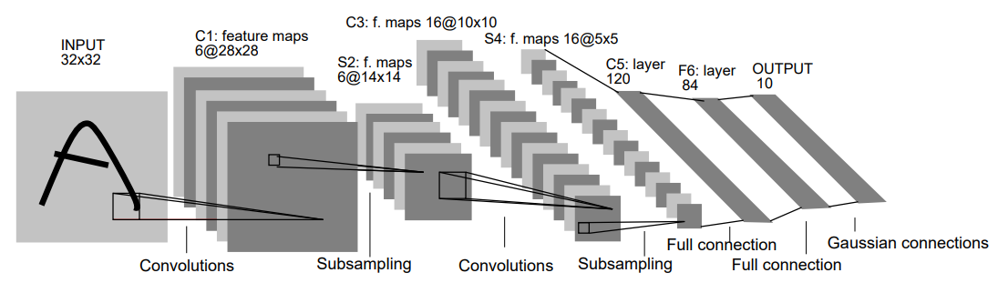
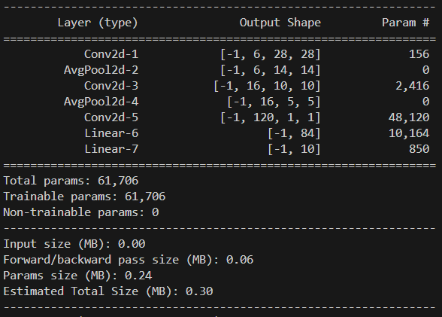
1.1 Implement Lenet-5 from Scratch And Show Model Architecture. (15%)
Click the button “1.1 Show Architecture”
Show the LeNet-5 model on terminal using torchsummary.summary().
(出題：Ying)
使用pre-trained VGG19
顯示架構
由於此作業使用灰階圖片, 所以須將3個通道修改成1個通道
(kernel size = 5, without padding)
(avarage pooling)
Figure: LeNet-5 model architecture
The -1 indicates that the actual size of batch size can vary.
Feature map shape
(Batch, Channels,
Height, Width)
Num. of param.
1. Click the button.
2. Show the architecture on terminal.
Figure: the architecture of LeNet-5

Slide 9
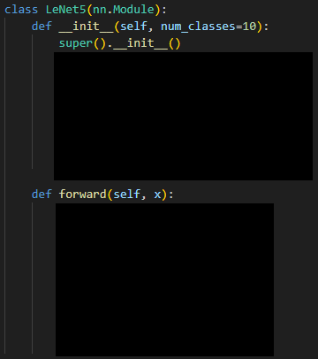
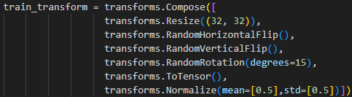
1.1 Implement Lenet-5 from Scratch And Show Model Architecture. (15%)
程式碼使用:
1. 實作出LeNet-5
2. 顯示架構
3. 下載MNIST 資料集，並將其設置為模型的訓練資料集
設定batch size
4. 損失函數 (loss function)使用交叉熵損失函數 (Cross-Entropy Loss)
5. 資料預處理和增強操作
(出題：Ying)
顯示架構
input size

Slide 10
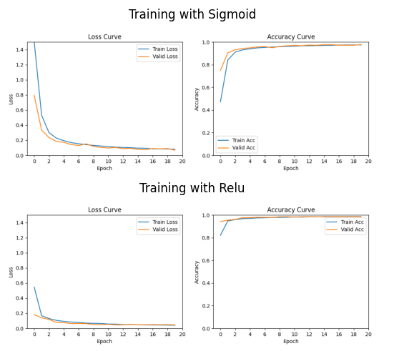
1.2 Evaluate Training And Validation Accuracy/Loss And Compare The Performance of Sigmoid And Relu Versions. (15%)
(出題：Ying)
At home:
Download the training and validation datasets.
Training and validating LeNet-5 at least 15 epochs at home and record the training/validation accuracy and loss for each with sigmoid and relu in each epoch .
If your validation accuracy is low, you can try
Adjust the learning rate of the optimizer.
Change the data augmentation techniques used.
Save weight file with highest validation accuracy.
Use matplotlib.pyplot.plot() to create a line chart for the training and validation loss and accuracy values and save the figure.
When the demo:
Click the button “1.2 Show Acc Loss”
Show the saved figure of Training/Validation loss and accuracy in a new window
2. Show the saved figure in a new window
1. Click the button.
Figure: training/validation accuracy and loss

Slide 11
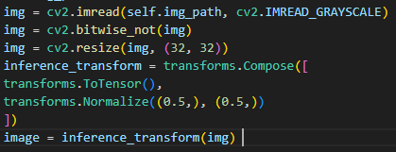
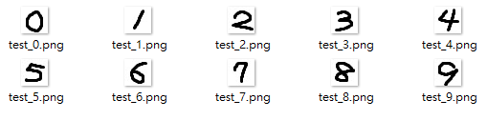
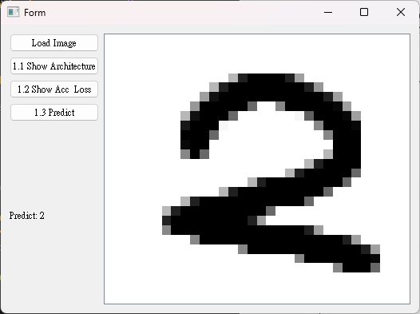
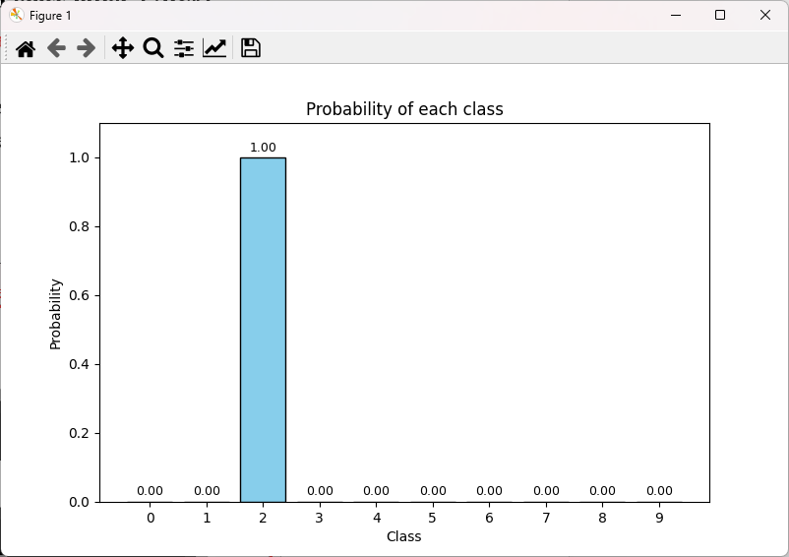
1.3 Use The Model with The Highest Validation Accuracy to Run Inference, And Show The Predicted Distribution And Class Label. (20%)
(出題：Ying)
Load the model with highest validation accuracy which trained with Relu at home.
Load the image from 140.116.154.28 -> Download/02_Homework/Hw2/Q1_TestData
Click the button “1.3 Predict” to run inference on the image which selected.
Show the predicted class label on the GUI.
Show the probability distribution of model predictions using a histogram in a new window.
白底黑字➔黑底白字(like training dataset)
Figure: test images (白底黑字, size: 28x28)
2. Show image
1. Load image
3. Show probability of each class
3. Predict

Slide 12
1.3 Use The Model with The Highest Validation Accuracy to Run Inference, And Show The Predicted Distribution And Class Label. (20%)
(出題：Ying)
The probability distribution of model prediction using a histogram.
Y-axis: probability
X-axis: class name

Slide 13
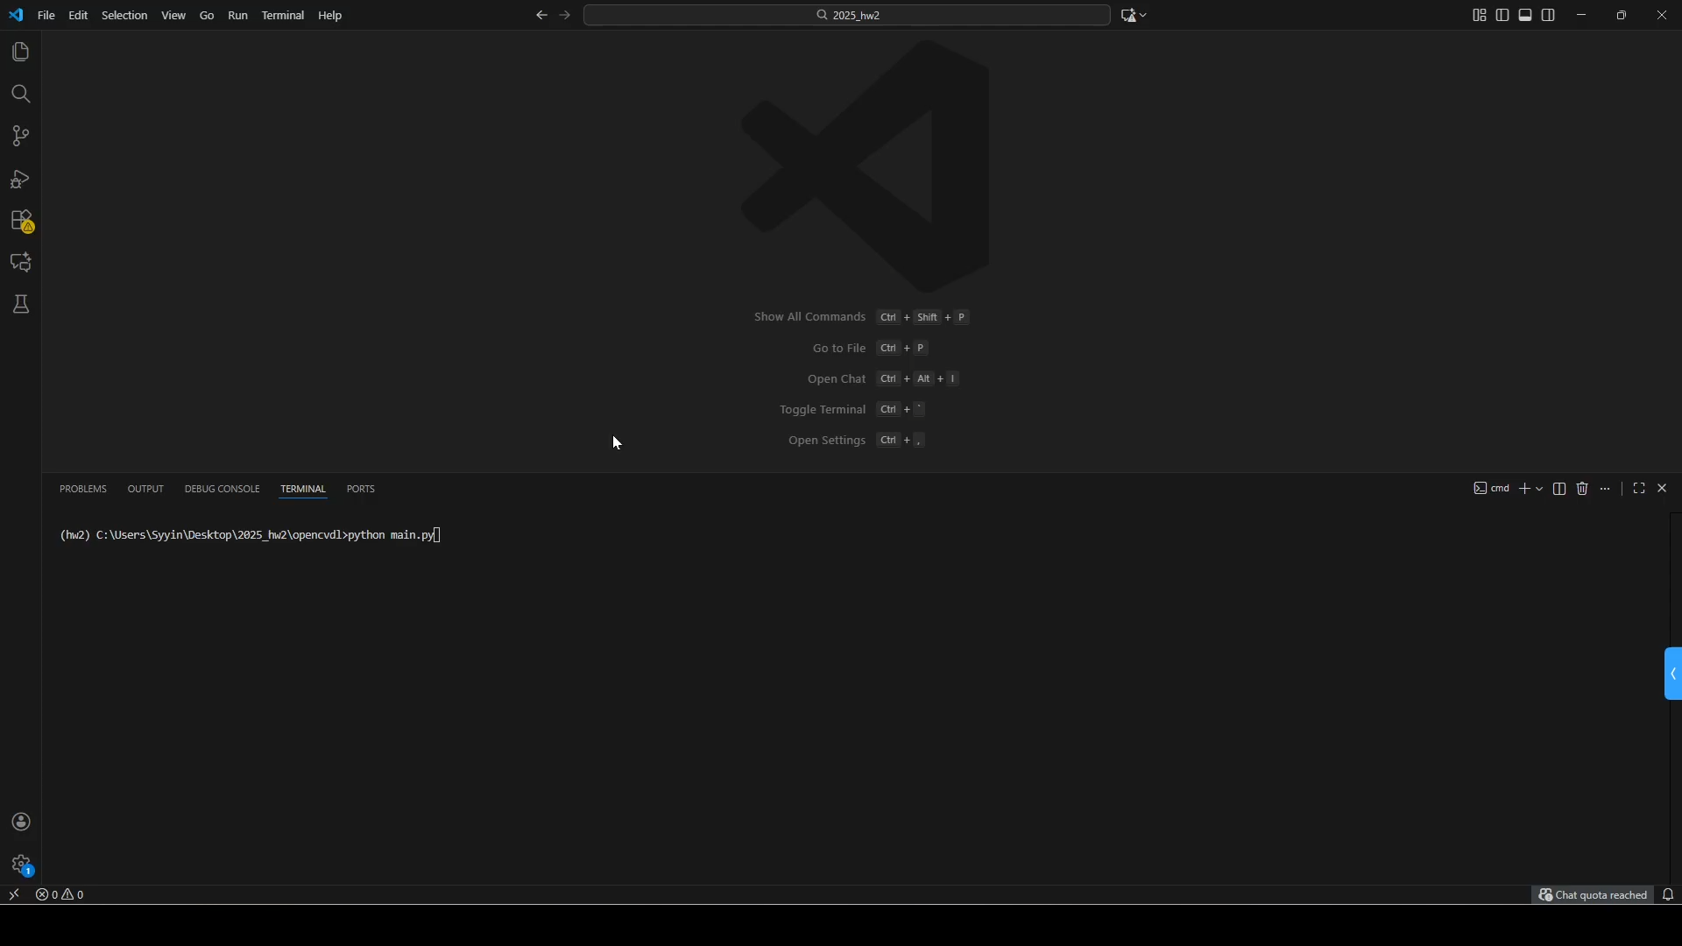
1. Train a MNIST Classifier using LeNet-5 – Example Video
(出題：Ying)
This is an example for demonstration.

Slide 14
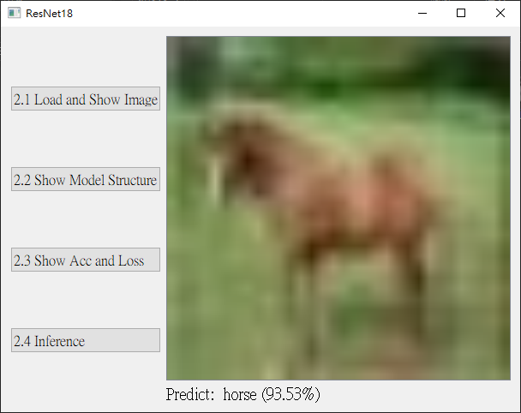
2. Train a CIFAR-10 Classifier Using ResNet18
(出題：Ian)
2.1 (10%) Load and Show the Image
2.2 (10%) Show the Architecture of ResNet18 Model
2.3 (15%) Show Training/Validating Loss Curve and Accuracy Curve
2.4 (15%) Use the Trained Model with Highest Validation Accuracy to Run Inference, Show the Probability Distribution and Class Label
Figure: GUI Example

Slide 15
Objective
Learn how to train a ResNet18 model to classify images of CIFAR-10 using PyTorch
Download CIFAR-10 Dataset
Image size: 32x32x3c (RGB)
10 classes: airplane, automobile, bird, cat, deer, dog, frog, horse, ship, and truck
Training: 50,000 images in total
Testing: 10,000 images in total
Datasets (Download from torchvision.dataset)
- torchvision.datasets.CIFAR10(data_path, download=True, train=True/False)
Training and Validation dataset: You should split training and validation by yourself. (Suggestion: 80% and 20%)
Inference dataset: 10,000 images in total. For demo: Download inference image (inference_img.zip) from FTP. There is a special image for demo.
2.0 Train a CIFAR-10 Classifier Using ResNet18
(出題：Ian)
I/P: Your data file path
I/P: Set to true to load training data else load testing data
I/P: Download dataset or not

Slide 16
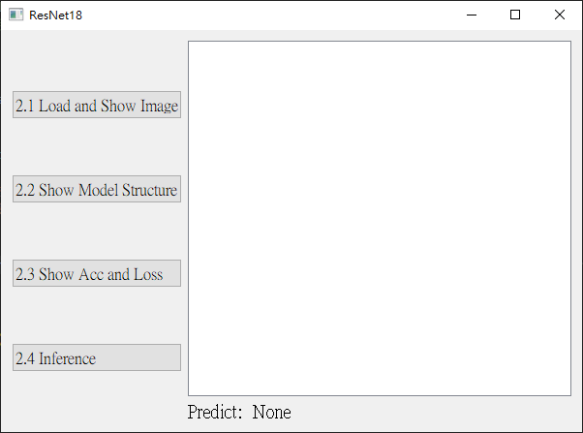
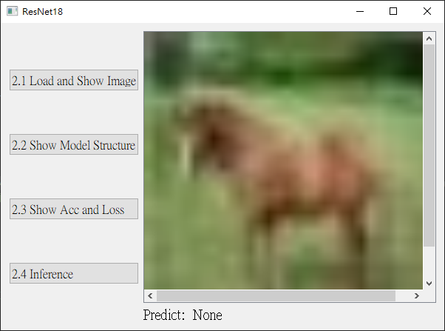
2.1 (10%) Load and Show the Image
At home:
Click the button “2.1 Load and Show Image”
Load an image
Resize images to 32x32×3c (RGB)
Show selected image on GUI
When the demo:
Click the button “2.1 Load and Show Image”
Load and show image on GUI
(出題：Ian)
Notice: this is an example, the images might differ

Slide 17
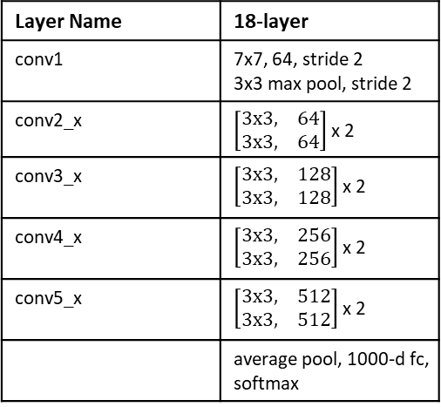
2.2 (10%) Show the Architecture of ResNet18 Model
(出題：Ian)
At home:
Replace 7x7 conv stride 2 with 3x3 conv stride 1 and remove max pooling to preserve feature information because CIFAR-10 image size is 32x32x3c (original input size is 224x224x3c)
Replace the output layer to a FC (Fully Connected) layer of 10 node
It’s because that the node of FC Layer in ResNet18 is 1000.
In our assignment, it only needs 10 nodes for 10 classes.
As a result, we have to replace it.
→ Hint:
- torch.nn.Linear(512, 10) ➔ in order to change the original FC Layer of model.
Run the function to show the structure in the terminal
When the demo:
Click the button “2.2 Show Model Structure”
Run the function to show the structure in the terminal
Layer Name | 18-layer
conv1 | 7x7, 64, stride 2 3x3 max pool, stride 2
conv2_x | $\left[\begin{matrix}3x3, & 64 \\ 3x3, & 64\end{matrix}\right]$ x 2
conv3_x | $\left[\begin{matrix}3x3, & 128 \\ 3x3, & 128\end{matrix}\right]$ x 2
conv4_x | $\left[\begin{matrix}3x3, & 256 \\ 3x3, & 256\end{matrix}\right]$ x 2
conv5_x | $\left[\begin{matrix}3x3, & 512 \\ 3x3, & 512\end{matrix}\right]$ x 2
 | average pool, 1000-d fc, softmax
I/P: Size of input feature map
I/P: Size of output
Original ResNet-18 architecture

Slide 18
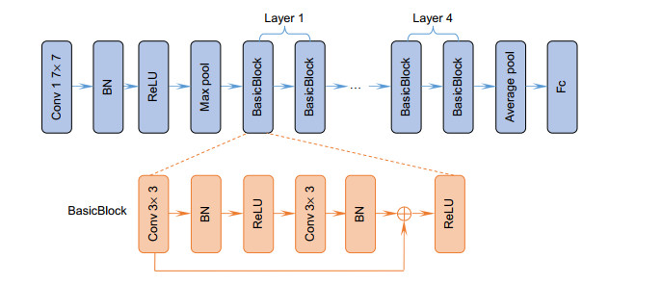
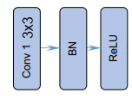
2.2 (10%) Show the Architecture of ResNet18 Model
The output structure of ResNet18 model
(出題：Ian)
ResNet(
(conv1): Conv2d(3, 64, kernel_size=(3, 3), stride=(1, 1), padding=(1, 1), bias=False)
(bn1): BatchNorm2d(64, eps=1e-05, momentum=0.1, affine=True, track_running_stats=True)
(relu): ReLU(inplace=True)
(layer1): Sequential(
(0): BasicBlock(
(conv1): Conv2d(64, 64, kernel_size=(3, 3), stride=(1, 1), padding=(1, 1), bias=False)
(bn1): BatchNorm2d(64, eps=1e-05, momentum=0.1, affine=True, track_running_stats=True)
(relu): ReLU(inplace=True)
(conv2): Conv2d(64, 64, kernel_size=(3, 3), stride=(1, 1), padding=(1, 1), bias=False)
(bn2): BatchNorm2d(64, eps=1e-05, momentum=0.1, affine=True, track_running_stats=True)
)
(1): BasicBlock(
(conv1): Conv2d(64, 64, kernel_size=(3, 3), stride=(1, 1), padding=(1, 1), bias=False)
(bn1): BatchNorm2d(64, eps=1e-05, momentum=0.1, affine=True, track_running_stats=True)
(relu): ReLU(inplace=True)
(conv2): Conv2d(64, 64, kernel_size=(3, 3), stride=(1, 1), padding=(1, 1), bias=False)
(bn2): BatchNorm2d(64, eps=1e-05, momentum=0.1, affine=True, track_running_stats=True)
)
)
Basic Block 含有這些，並不是順序。
順序需要自己實作(可參考下面的圖)。
…
(avgpool): AdaptiveAvgPool2d(output_size=(1, 1))
(fc): Linear(in_features=512, out_features=10, bias=True)
)
(Residual Block)

Slide 19
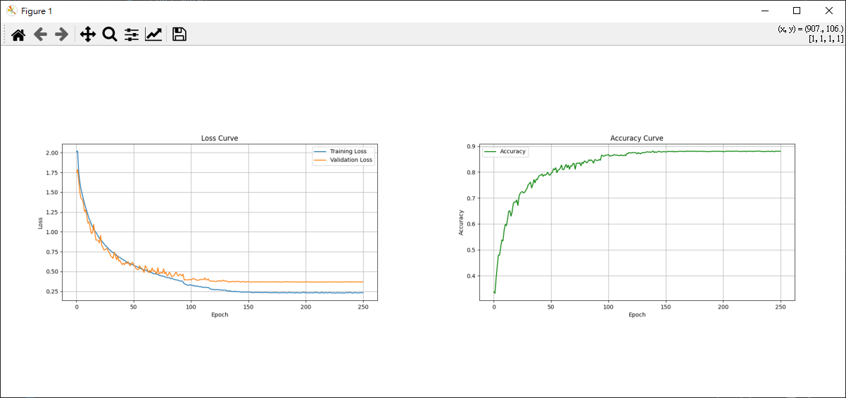
2.3 (15%) Show Training/Validating Loss Curve and Accuracy Curve
At home:
Download the datasets from torchvision.dataset, and split training and validation dataset.
Training and validating ResNet-18 at home and record the training/validation loss and accuracy curve for each epoch.
Use matplotlib.pyplot.plot() to create a line chart for the training and validation loss and accuracy values then save the figure.
Save weight file with highest validation accuracy.
When the demo:
Click the button “2.3 Show Acc and Loss”
Show the saved figure of Training/Validating loss and accuracy.
(出題：Ian)
The output of loss curve and accuracy curve

Slide 20
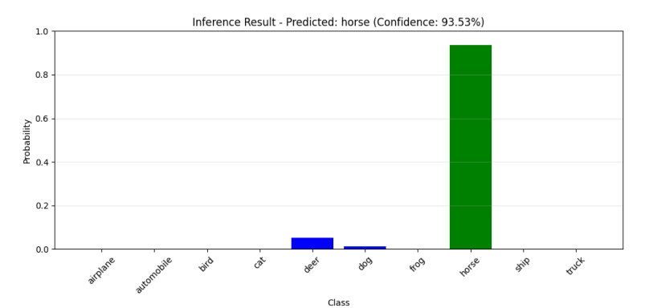
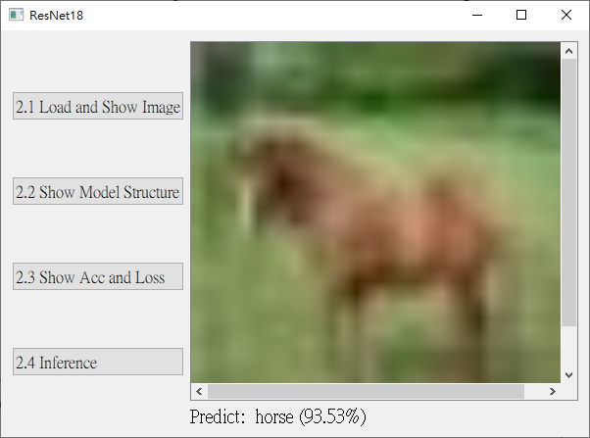
2.4 (15%) Use the Trained Model with Highest Validation Accuracy to Run Inference, Show the Probability Distribution and Class Label
When the demo:
Load the trained model with highest validation accuracy.
Resize the image to 32x32x3c (RGB)
Click the button “2.4 Inference” to run inference on the image you selected.
Note that there is a special image in the inference dataset that is not included in the 10 classes of CIFAR-10. You should set a threshold (adjust it yourself) to determine whether the image belongs to 10 classes in the CIFAR-10 dataset.
Show the predicted class label and confidence score on GUI.
Show the probability distribution of model predictions using a histogram.
➔ Hint: If the max probability < threshold, the image is not in 10 classes.
(出題：Ian)
Show the predicted class label and probability(confidence score)
The output of probability distribution
Image in 10 classes of CIFAR-10

Slide 21
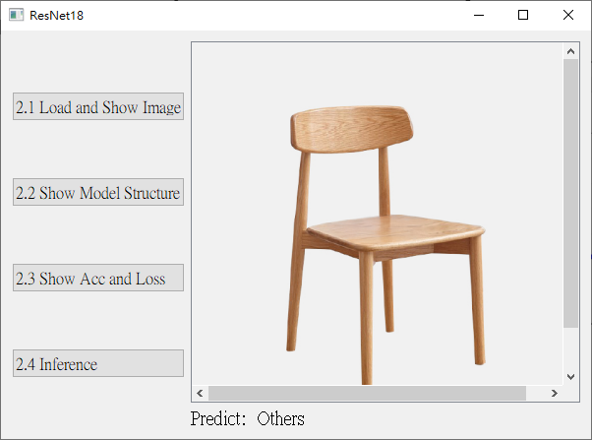
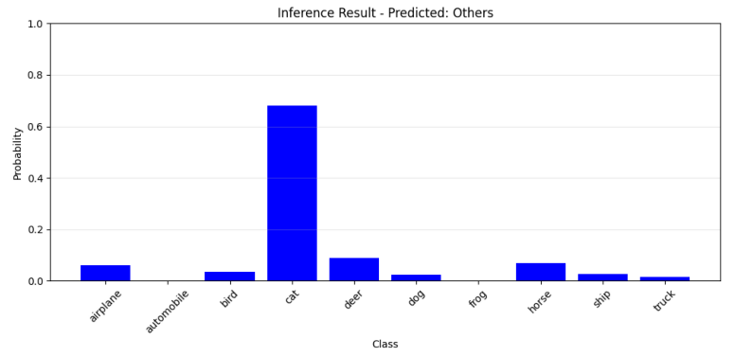
2.4 (15%) Use the Trained Model with Highest Validation Accuracy to Run Inference, Show the Probability Distribution and Class Label
When the demo:
Load the trained model with highest validation accuracy.
Resize the image to 32x32x3c (RGB)
Click the button “2.4 Inference” to run inference on the image you selected.
Note that there is a special image in the inference dataset that is not included in the 10 classes of CIFAR-10. You should set a threshold (adjust it yourself) to determine whether the image belongs to 10 classes in the CIFAR-10 dataset.
Show the predicted class label and confidence score on GUI.
Show the probability distribution of model predictions using a histogram.
➔ Hint: If the max probability < threshold, the image is not in 10 classes.
(出題：Ian)
Because the max probability < threshold, the predict class label is “Others”
The output of probability distribution
Image not in 10 classes of CIFAR-10

Slide 22
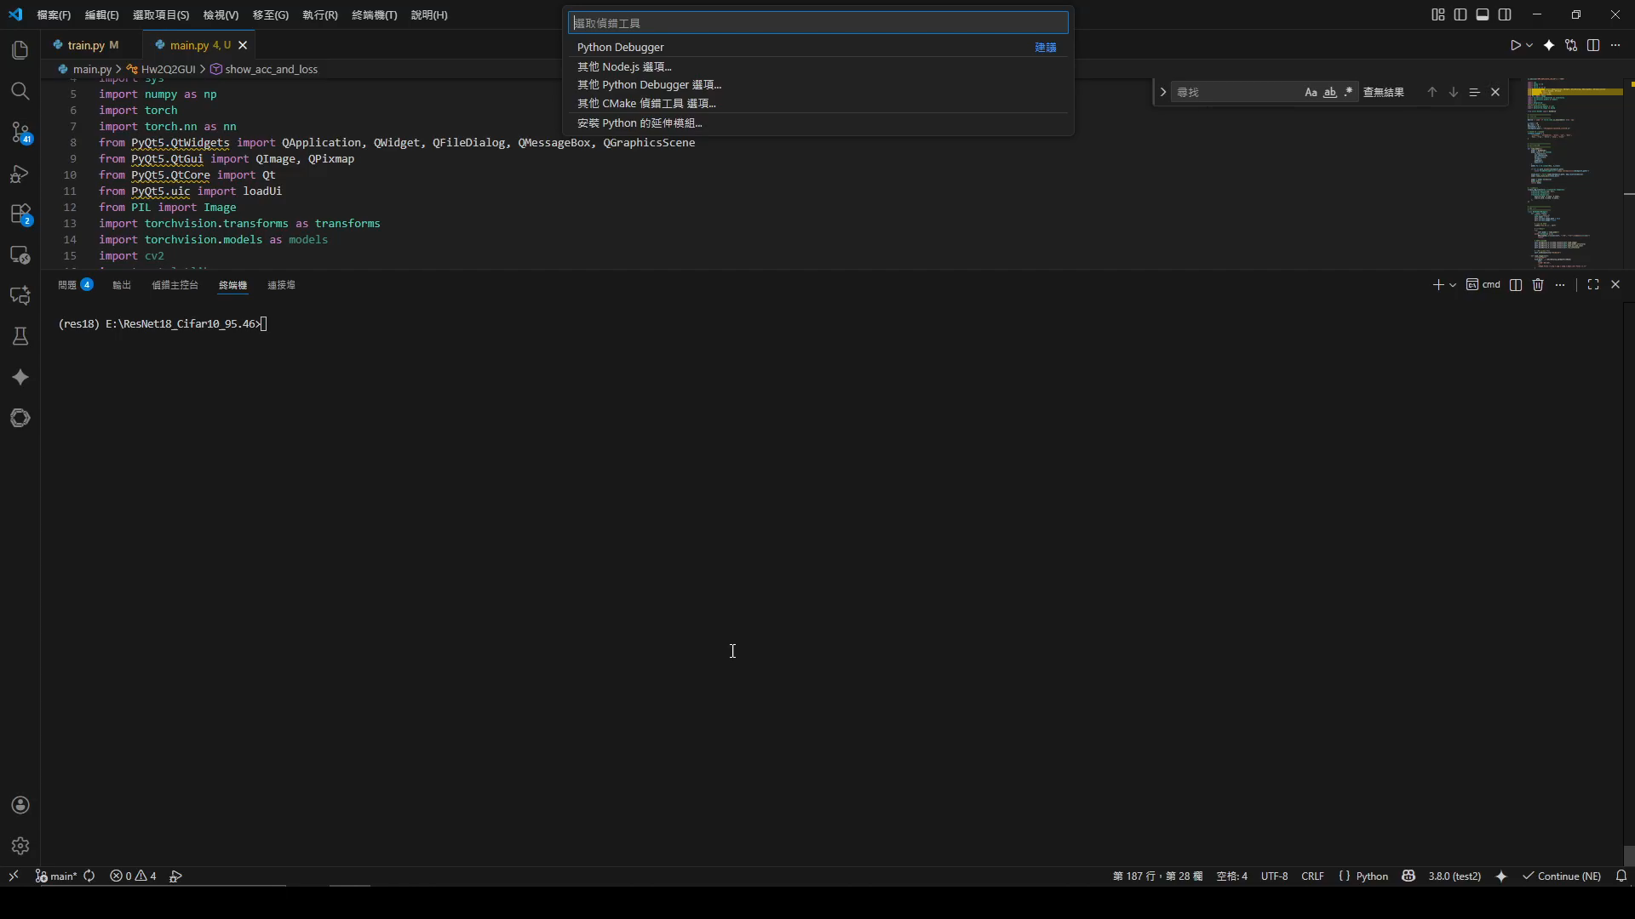
2. Train a CIFAR-10 Classifier Using ResNet18
(出題：Ian)
This is an example for demonstration.

